Slide 1
Implementing DFA Using JAVA Socket Programming
NAME: VIKRANT SHARMA
USN: 1NH15CS758
SEM: VI
SEC: C

Slide 2
INTRODUCTION
The aim of the project is to build a code that implements a DFA. The idea is to implement it using client and server program. The program takes string as an input , and it should print the states the string goes through and prints whether the string is accepted by the DFA or not accepted by the DFA.
The client-server is implemented using socket programming. The input is accepted at the client end , this input is further sent to the server. The server accepts the input from the socket streams, and it runs the DFA module, here the string is checked for the validity according to the given DFA.
It shows all the states passed by the string and displays whether the string is accepted or not accepted by the given DFA.

Slide 3
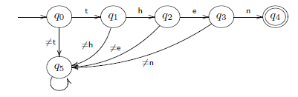
SAMPLE DFA
Only the word then is accepted
Here Q = {q0, q1, q2, q3, q4}
∑ is the set of all characters
F = {q4}
We have a “stop” or “dead” state q5, not accepting

Slide 4
IMPLEMENTATION OF DFA
In the program , I have implemented a DFA which accepts the substring “good” present in a a given string and shows the index at which it is present.
The class dfa contains five methods in it . Each methods represents the states of the dfa.
The methods are START, Q0,Q1, Q2, Qf .
Method START denotes start state and returns one if the character is 'g' and returns false for any other character.
Method Q0 returns 1 if the character is 'g' ,it returns 2 if the character is 'o' and returns false or 0 for any other character encountered.
Method Q1 returns 1 if the character is 'g' ,it returns 3 if the character is 'o' and returns false or 0 for any other character encountered.

Slide 5
IMPLEMENTATION OF DFA
Method Q2 returns 1 if the character is 'g' ,it returns 4 if the character is 'd' and returns false or 0 for any other character encountered.
Method Q0 displays the index at which the “good” is found and displays accepted and returns false or 0 for any character encountered.
The class pro extends class dfa and contains a method pro.
The method pro takes string as an argument and process the whole string from start till the end, changing the states it goes through.

Slide 6
SOCKET PROGRAMMING
INTRODUCTION
Internet and WWW have emerged as global ubiquitous media for communication and changed the way we conduct science, engineering, and commerce.
This created a huge demand for software designers and engineers with skills in creating new Internet-enabled applications or porting existing/legacy applications to the Internet platform.
The key elements for developing Internet-enabled applications are a good understanding of the issues involved in implementing distributed applications and sound knowledge of the fundamental network programming models.

Slide 7
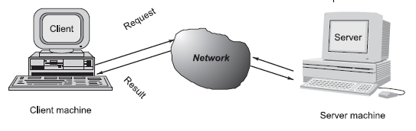
CLIENT/SERVER COMMUNICATION
At a basic level, network-based systems consist of a server, client, and a media for communication.
As shown in Fig. A computer running a program that makes a request for services is called client machine.
A computer running a program that offers requested services from one or more clients is called server machine.
The media for communication can be wired or wireless network.

Slide 8
CLIENT/SERVER COMMUNICATION
Generally, programs running on client machines make requests to a program (often called as server program) running on a server machine.
They involve networking services provided by the transport layer, which is part of the Internet software stack.
The transport layer comprises two types of protocols, TCP (Transport Control Protocol) and UDP (User Datagram Protocol).
The most widely used programming interfaces for these protocols are sockets.
TCP is a connection-oriented protocol that provides a reliable flow of data between two computers. Example applications that use such services are HTTP, FTP, and Telnet.
UDP is a protocol that sends independent packets of data, called datagrams, from one computer to another with no guarantees about arrival and sequencing. Example applications that use such services include Clock server and Ping.

Slide 9
SOCKETS AND SOCKET BASED COMMUNICATION
Sockets provide an interface for programming networks at the transport layer. Network communication using Sockets is very much similar to performing file I/O.
In fact, socket handle is treated like file handle. The streams used in file I/O operation are also applicable to socket-based I/O.
Socket-based communication is independent of a programming language used for implementing it. That means, a socket program written in Java language can communicate to a program written in non-Java (say C or C++) socket program.
A server (program) runs on a specific computer and has a socket that is bound to a specific port. The server listens to the socket for a client to make a connection request.

Slide 10
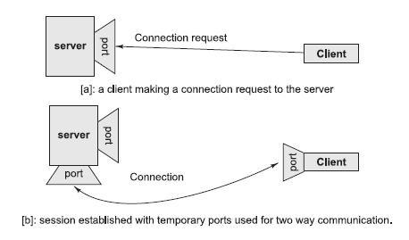
SOCKETS AND SOCKET BASED COMMUNICATION
If everything goes well, the server accepts the connection . Upon acceptance, the server gets a new socket bound to a different port. It needs a new socket (consequently a different port number) so that it can continue to listen to the original socket for connection requests while serving the connected client.

Slide 11
CONCLUSION
The objective of the project is achieved that was to build a Client- Server program to implement a DFA. In order to achieve this, I have used socket programming. The Program display each and every state of the strings goes through in a given DFA. And, it displays whether the given string is accepted by the DFA.

Slide 12
Thank You

